Slide 1

Appraised Home Values
Ikaika Smith
Dillon May

Slide 2
Summary/Overview
Our project is focused on predicting home appraisal values. We wanted to see what factors/variables contribute to home appraisal values. Use correlation to see how each data point associates with each other. We’ll also fit a linear regression model to the home appraisal data to create a predictive model. We’ll also fit and compare a Lasso Regression and Ridge Regression model to the data to compare the performance of the two models.

Slide 3

Clean the data
Remove variables/columns that are not needed
Make sure that all data is not null and drop all Na/NaN values
Handle any missing values
Convert data types
Remove any special characters

Slide 4

Explore the data
Visualize the data
Describe the datasets we were going to use
Look at size, quality and accuracy of data

Slide 5
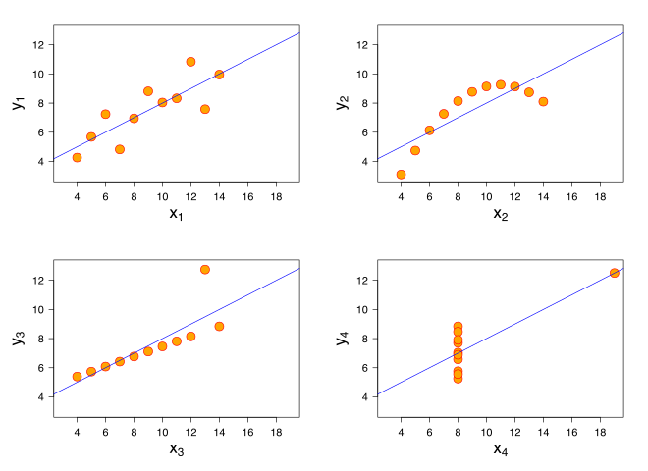



Models used
Linear Regression
Ridge Regression
Lasso Regression

Slide 6
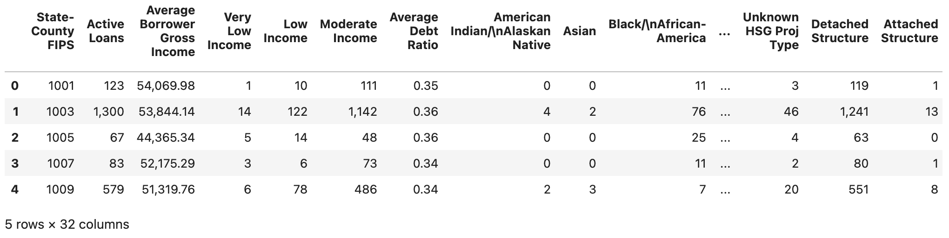
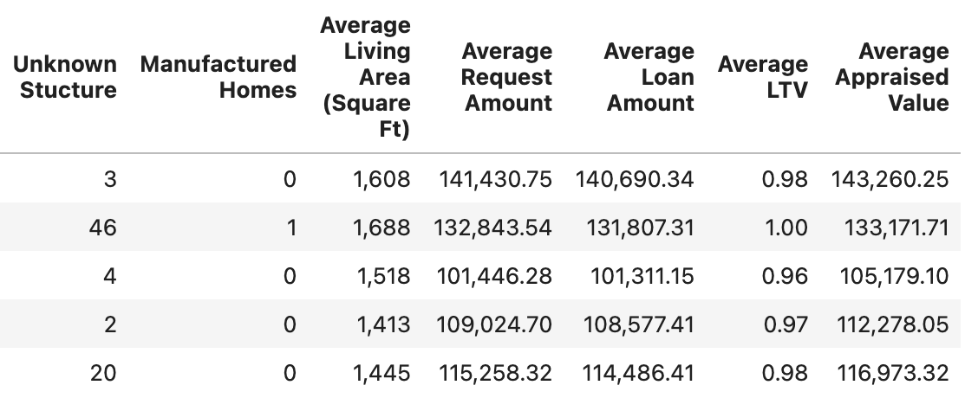
Original Data

Slide 7
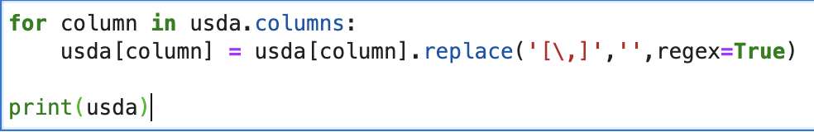
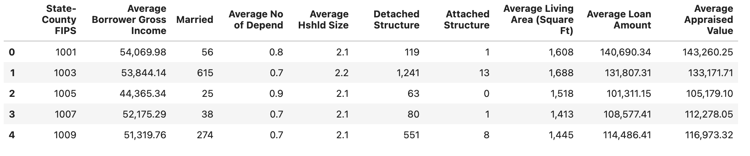
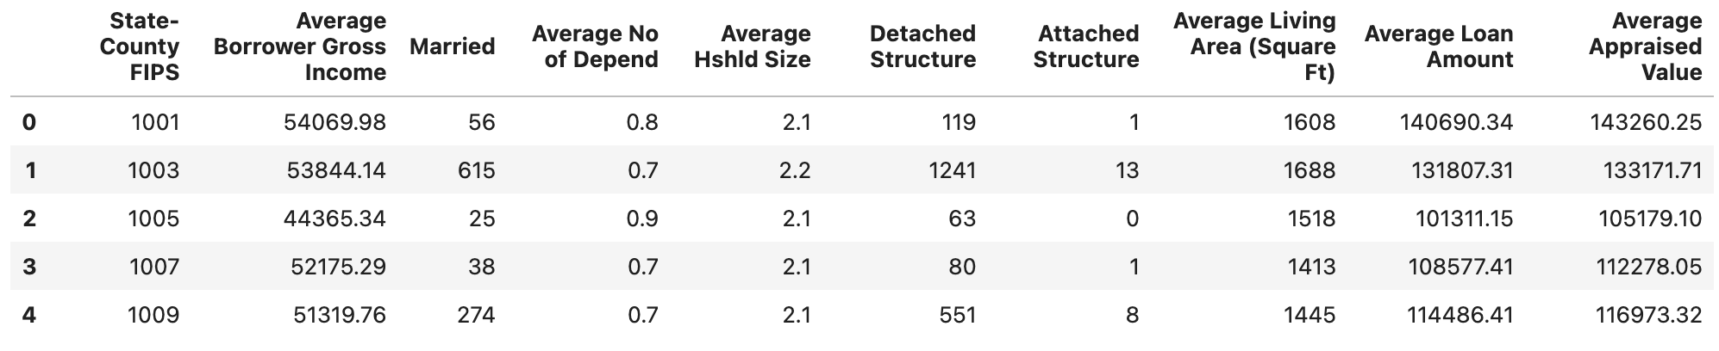
The New data

Slide 8
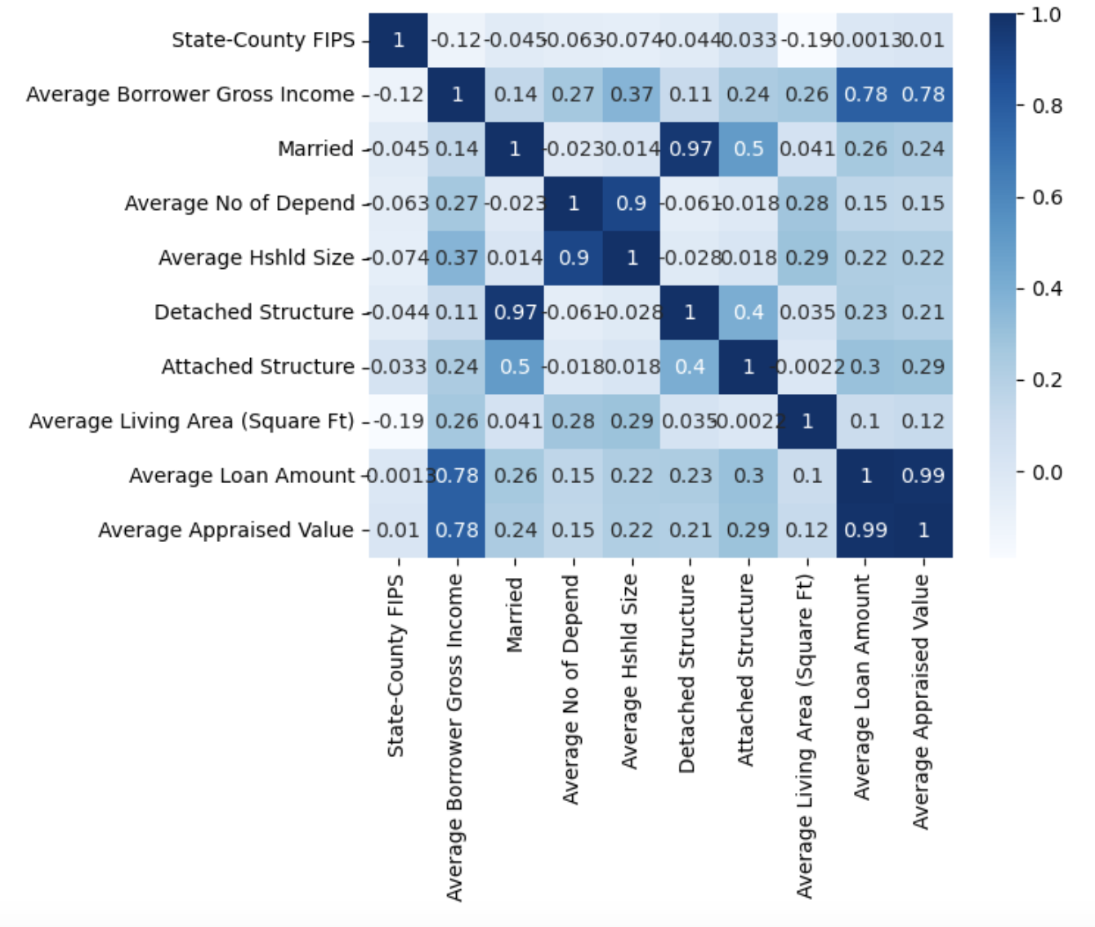
Correlation

Slide 9
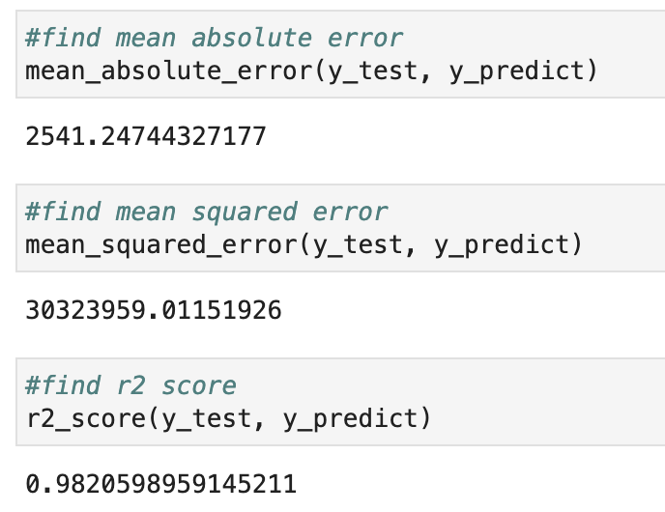
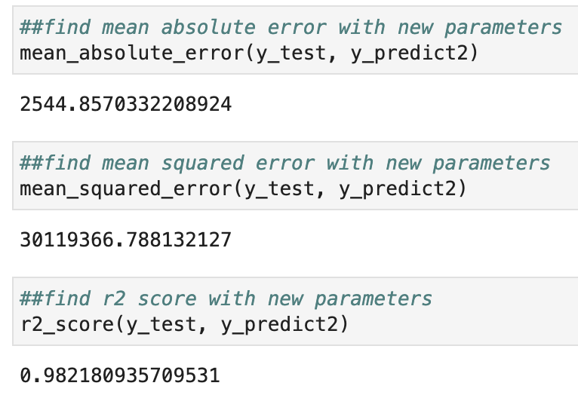
Metrics for lasso regression

Slide 10
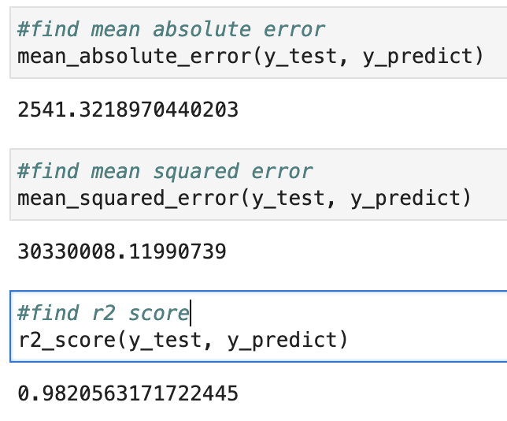
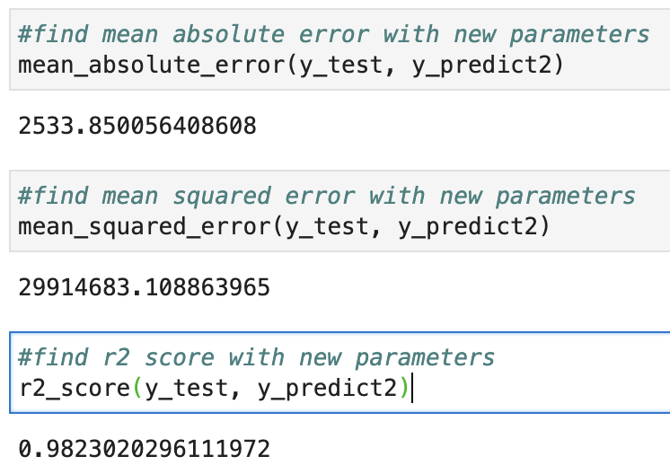
Metrics for Ridge Regression

Slide 11
Comparing Metrics
Lasso
Ridge

Slide 12
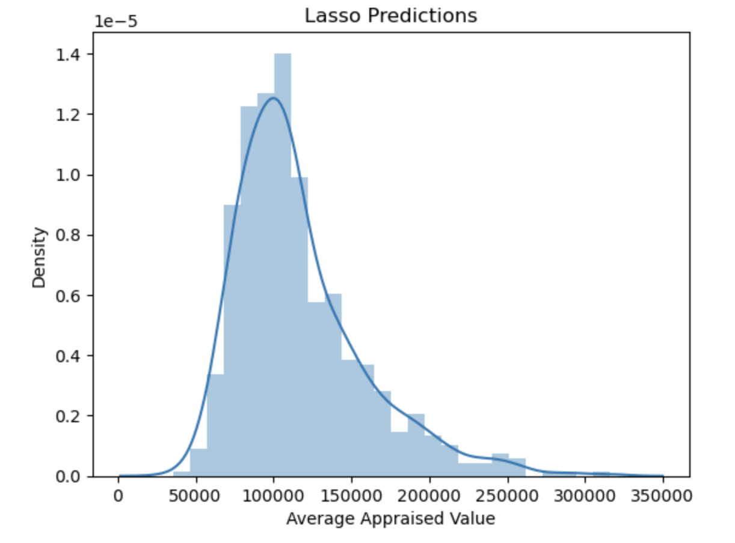
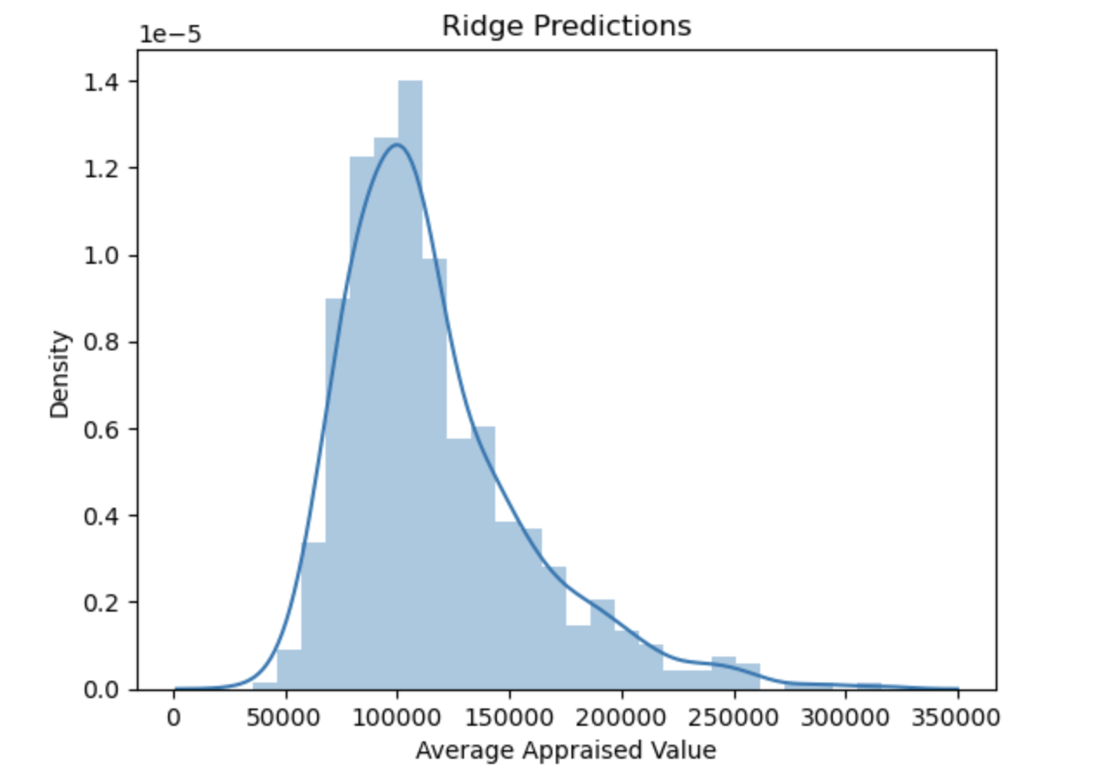
Comparing Distplots

Slide 13
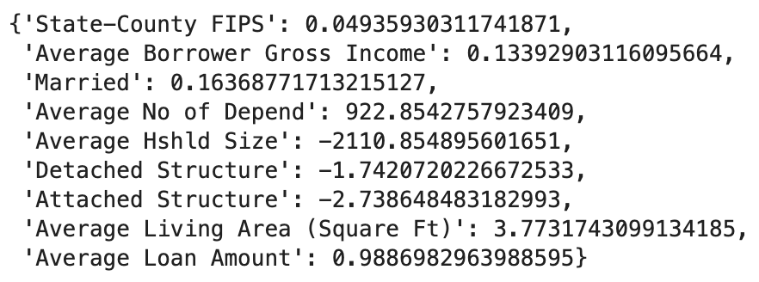
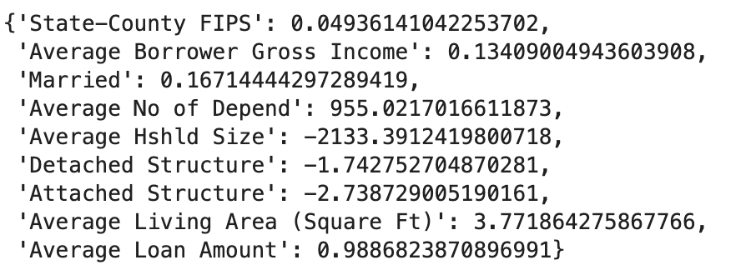
Coefficients
Lasso
Ridge

Slide 14
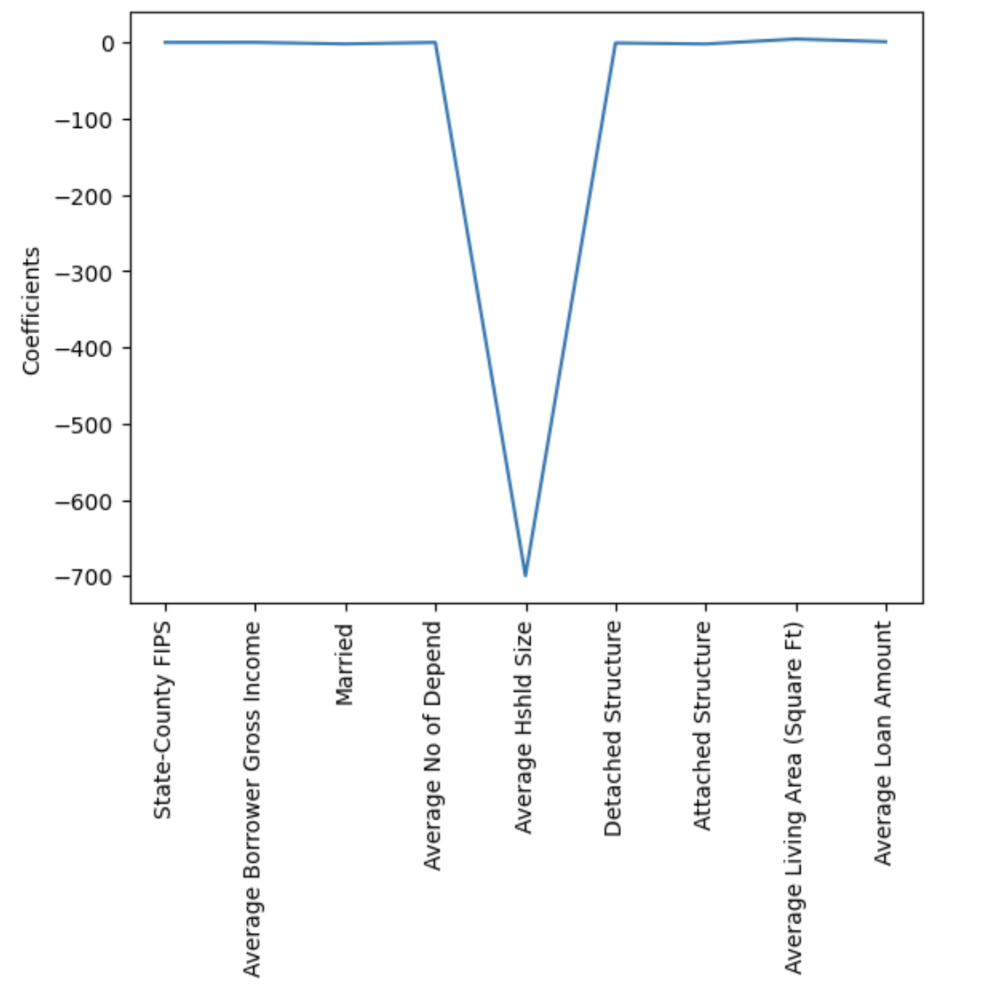
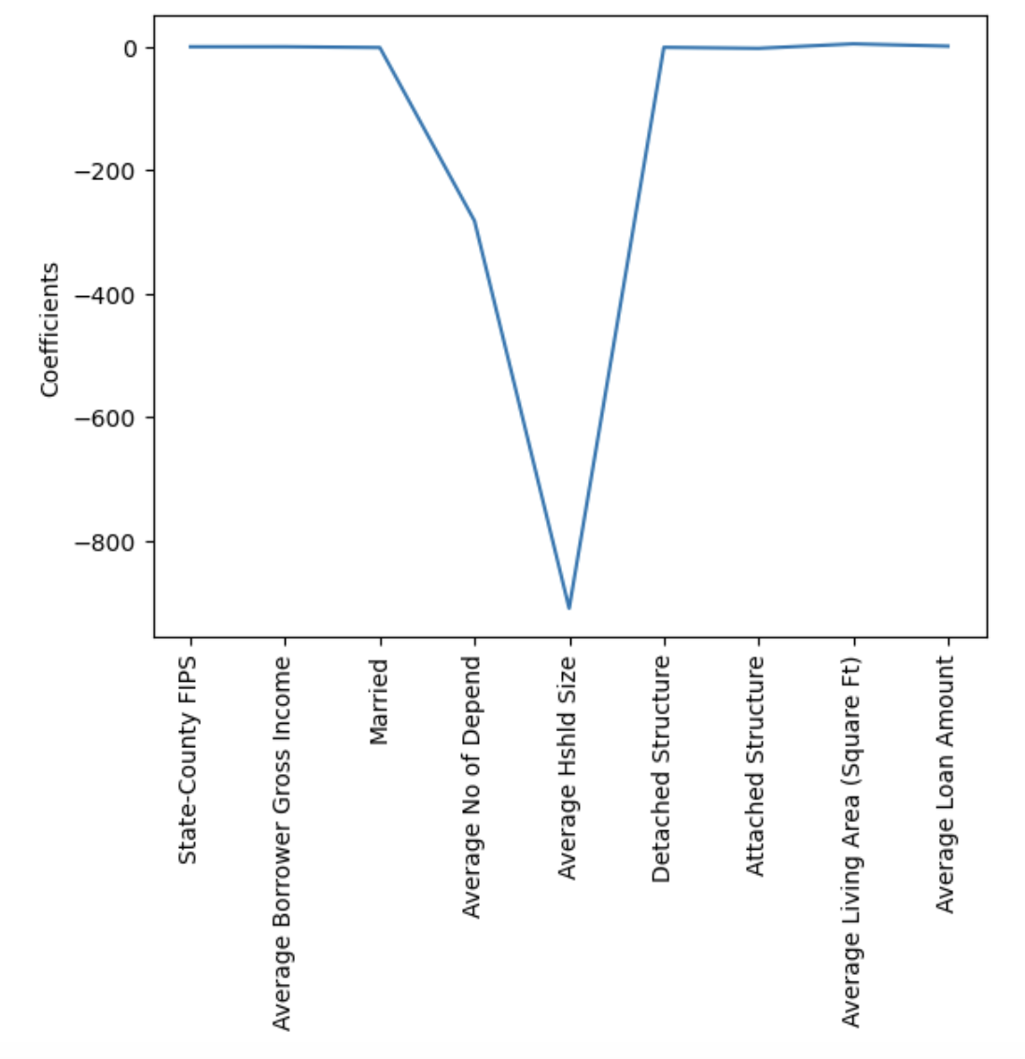
Comparing coefficients
Lasso
Ridge

Slide 15
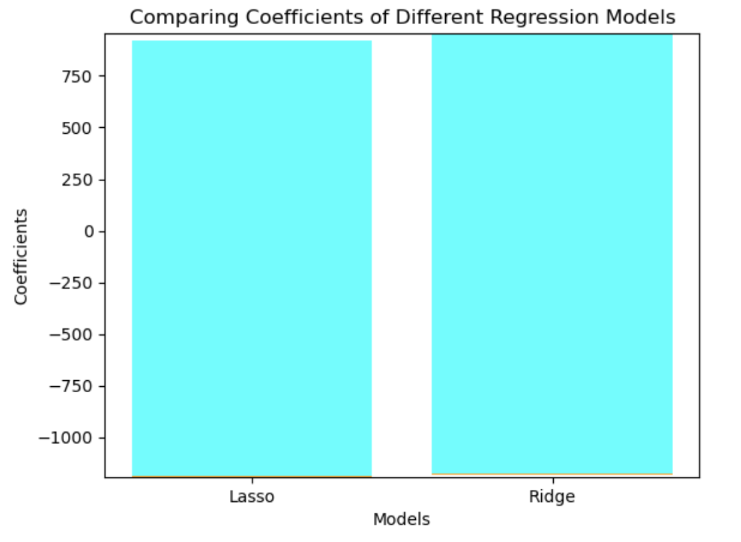
Comparing Coefficients of both models

Slide 16
Conclusions
Seems as though the models used for this data set was not the best models to be used.
For both Lasso and Ridge their coefficients were extremely far off from 0 and 1
However, r2 scored nearly close to 1 so that was the best fit for the data.

Slide 17
Metrics For Linear Regression
print("Mean squared error: %.2f" %mean_squared_error(y_test, predictions))
Mean squared error: 818744928.77
print("Coefficient of determination: %2f" %r2_score(y_test, predictions))
Coefficient of determination: 0.487856

Slide 18
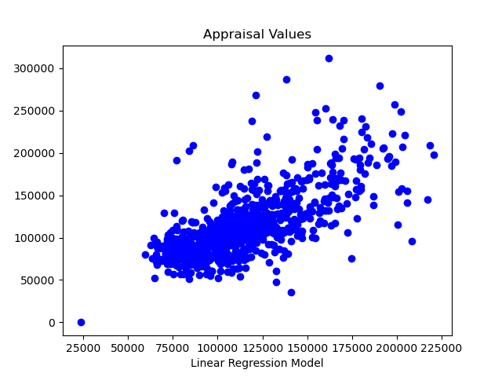
Predictions- Linear Regression

Slide 19
Linear Regression Summary
-Correlation between FIPS codes and appraisal values.
-Model has too many features I believe to accurately predict appraisal values.
-Would not recommend using this Linear Regression Model at this time.

